Slide 1
Recommendation system for Energy sustainable TV set using collaborative filtering
Theme: Digital Energy and Supply Chain

Slide 2
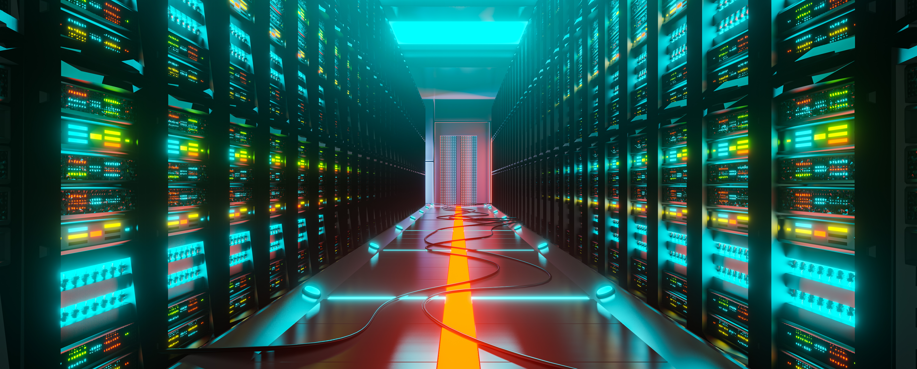
Data Driven Decision and Optimization for Energy Consumption
With the Data kicking in into out energy supply chain , there is a huge opportunity to optimize its consumption and comparison with the renewable alternatives. A data- driven tool to analyze and inform the public about shifting to new alternatives is much needed at this hour

Slide 3
Addressing the problem
Energy is fundamental for socio-economic development.
The availability of and access to energy and energy sources are particularly essential to poverty reduction and further improvements in standard of living.
However, at the same time, with the constantly increasing demand for energy, there are growing concerns about the sustainability and reliability of current production and consumption patterns and the impact of the use of fossil fuel on the environment

Slide 4
Solution
Introducing :-
Renerzie
An AI model which takes in user data and suggests the best energy efficient alternative to them using a widely used Machine learning technique Collaborative filtering
A recommendation system is a tool that helps customers to make a decision by suggesting products that are most relevant to their interests and preferences.

Slide 5
Renerzie
User A
Previous TV Data
Monthly bill
Hours/
day run
Model
Hours /day standby
In the present day, with the abundance of electronic devices in the market, choosing the right product has become a daunting task. One such device is a LED TV, where customers are faced with an overwhelming number of options with different features and price points.
Let us look into the case of a LED TV recommendation system, it would analyze the electric bill and hours per day of use for different users and make recommendations based on that data.
Locality
Processing
TV1 TV2 TV3

Slide 6
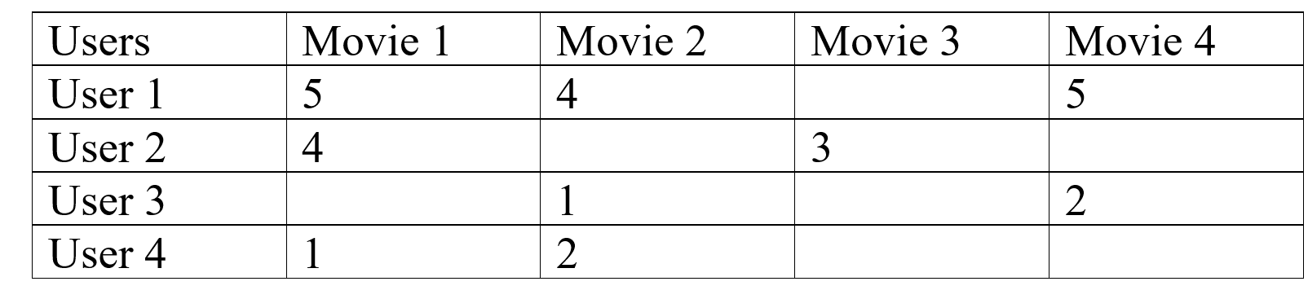
How it Works?
A simple example of the movie recommendation system will help us in explaining:
As I have mentioned before, the core principal by which renergzie works with is collaborative filtering.
In Collaborative Filtering, we tend to find similar users and recommend what similar users like. In this type of recommendation system, we don’t use the features of the item to recommend it, rather we classify the users into the clusters of similar types, and recommend each user according to the preference of its cluster.

Slide 7
How Renerzie takes the advantage
of Collaborative filtering
Locality:
Same locality ensures the average monthly income of the people staying in that locality is more or less likely the same, giving the AI some usefull information about the user’s background
Monthly Bill :
Suggestion is made by taking the weighted average of the electric bill and hours per day of use of similar users, where the weights are the similarities between the given user and the other users.
Previous set data:
The number of hours run per day
The number of hours the TV set was on standby
This information helps the ai to calculate the approximately monthly bill their previous set takes in

Slide 8
Similiarity between Renerzie and conventional Collaborative filtering works for a movie recommendation
Movie recommendation system
Tv set recommendation system(Renerzie)
Recommend users the items which are liked by the users of similar interest domain.
The rating which the users give to movie becomes the basis of comparisons
The locality of the user ensures this that the TV which would be recommended by the AI while be tested and found beneficial by other users of their locality
Where as here the electric bill along with the hours run per day are normalize to give a score which again becomes the basis of comparision

Slide 9
Benefits:-
The LED TV recommendation system has several benefits for both customers and manufacturers. For customers, the recommendation system makes it easier to find a TV that meets their needs and preferences by suggesting products that are similar to the ones they already use. This reduces the time and effort required to make a decision and increases the chances of finding a product that the customer will be satisfied with.
The analysis of energy consumption patterns provides additional benefits for customers. By providing recommendations on how to reduce energy consumption, the program can help customers save on their electric bills and reduce their carbon footprint.
For manufacturers, the recommendation system can help to increase sales by suggesting products to customers who are likely to be interested in them. Additionally, the data collected by the recommendation system can be used to gain insights into customer behavior and preferences, which can inform product development and marketing strategies.

Slide 10
Future Application :
The LED TV recommendation system using collaborative filtering has a lot of potential for future applications. For example, it could be extended to make recommendations for other electronics products, such as smartphones, laptops, and gaming consoles. Additionally, the recommendation system could be enhanced by incorporating other factors, such as demographics, location, and purchase history, to make more accurate recommendations.
Another potential application of the recommendation system is in the field of energy management. By analyzing the electric bill and hours per day of use of different users, the recommendation system could provide insights into energy consumption patterns and suggest ways to reduce

Slide 11
THANK YOU

